Slide 1
Delivery 2: G.A.L.S.
Sophia Appicelli, Kyle Gil Tan, Andrew Lim, Ashley Sachdeva

Slide 2
Introduction and Overview
Initially built low fidelity paper sketches for each page
Disposable, fast construction
Establish general layout and element locations
Followed up with medium fidelity HTML prototypes
Low clutter, plainly visible elements
Easy separation and data organization
Functioning buttons, but no link between pages
Notes:
Functioning buttons, but no links between pages

Slide 3
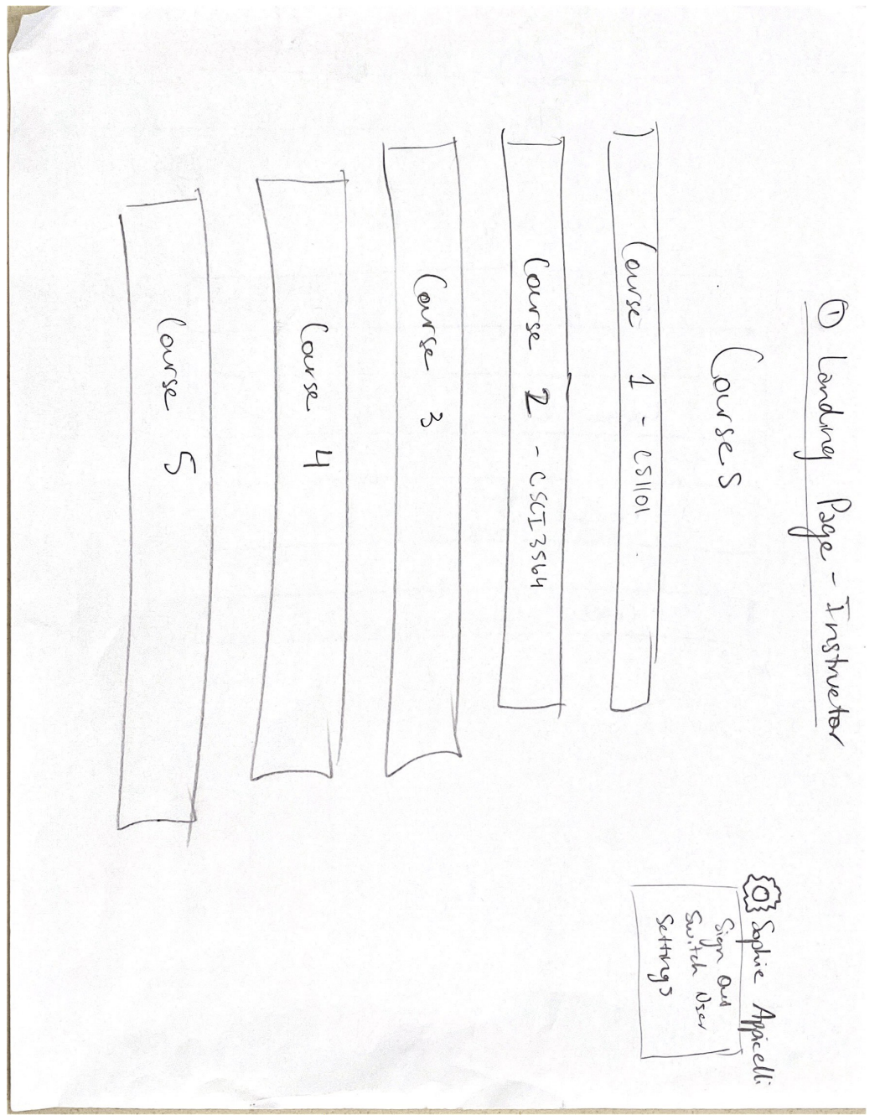
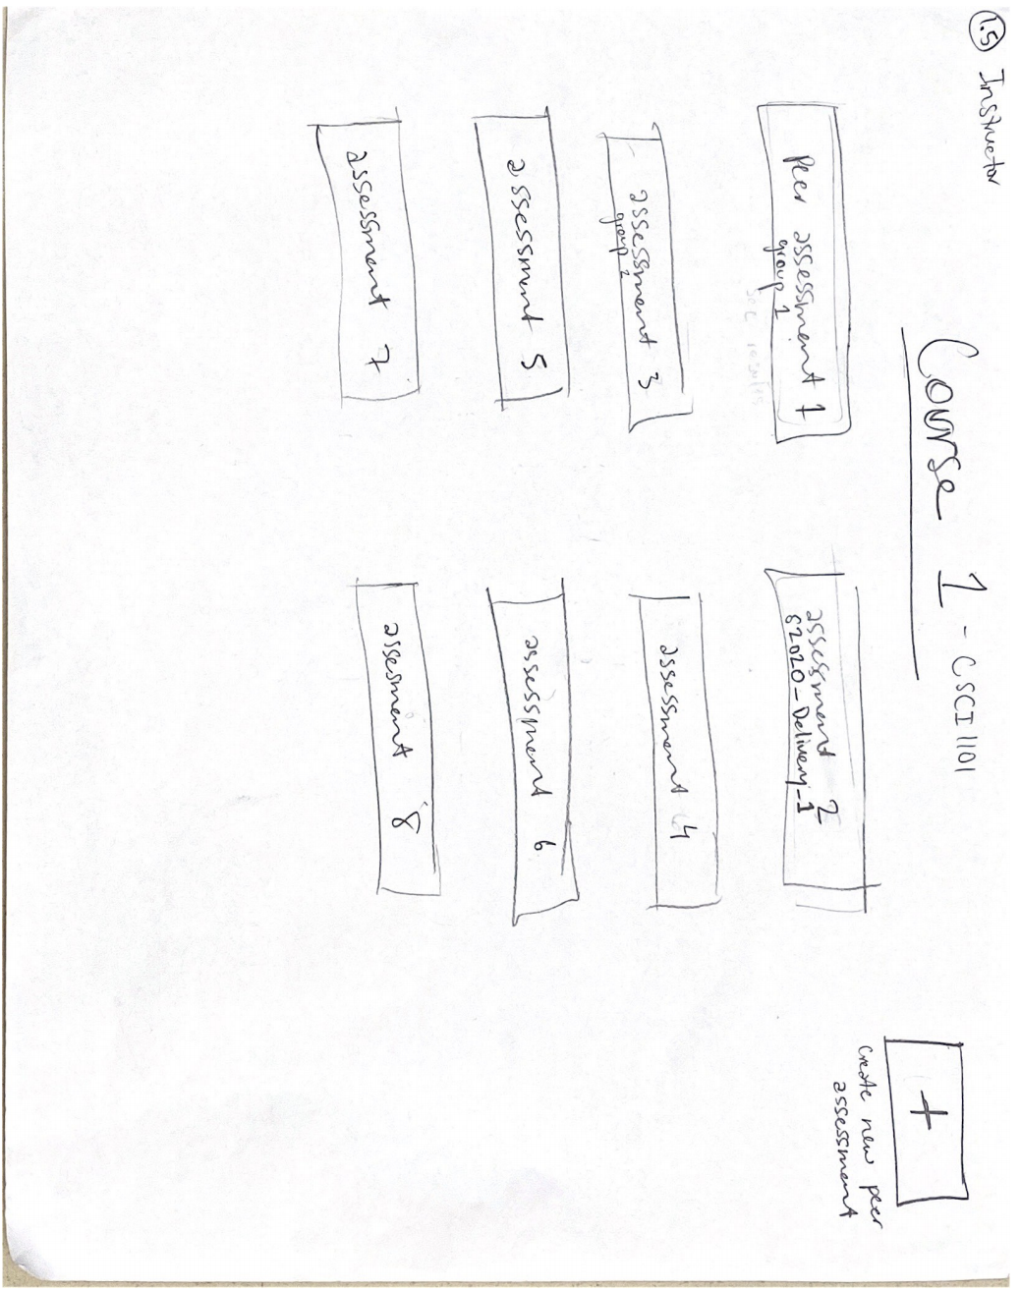
Instructor Landing Page
Instructor landing page displays all current courses taught by instructor
After selecting course, instructor is redirected to peer assessments for given course
Clear segmentation of which assessments belong to which course
Visible button to create new assessment

Slide 4
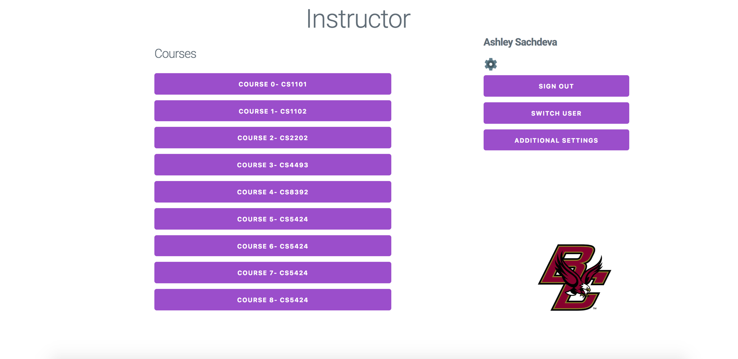
Instructor Landing Page

Slide 5
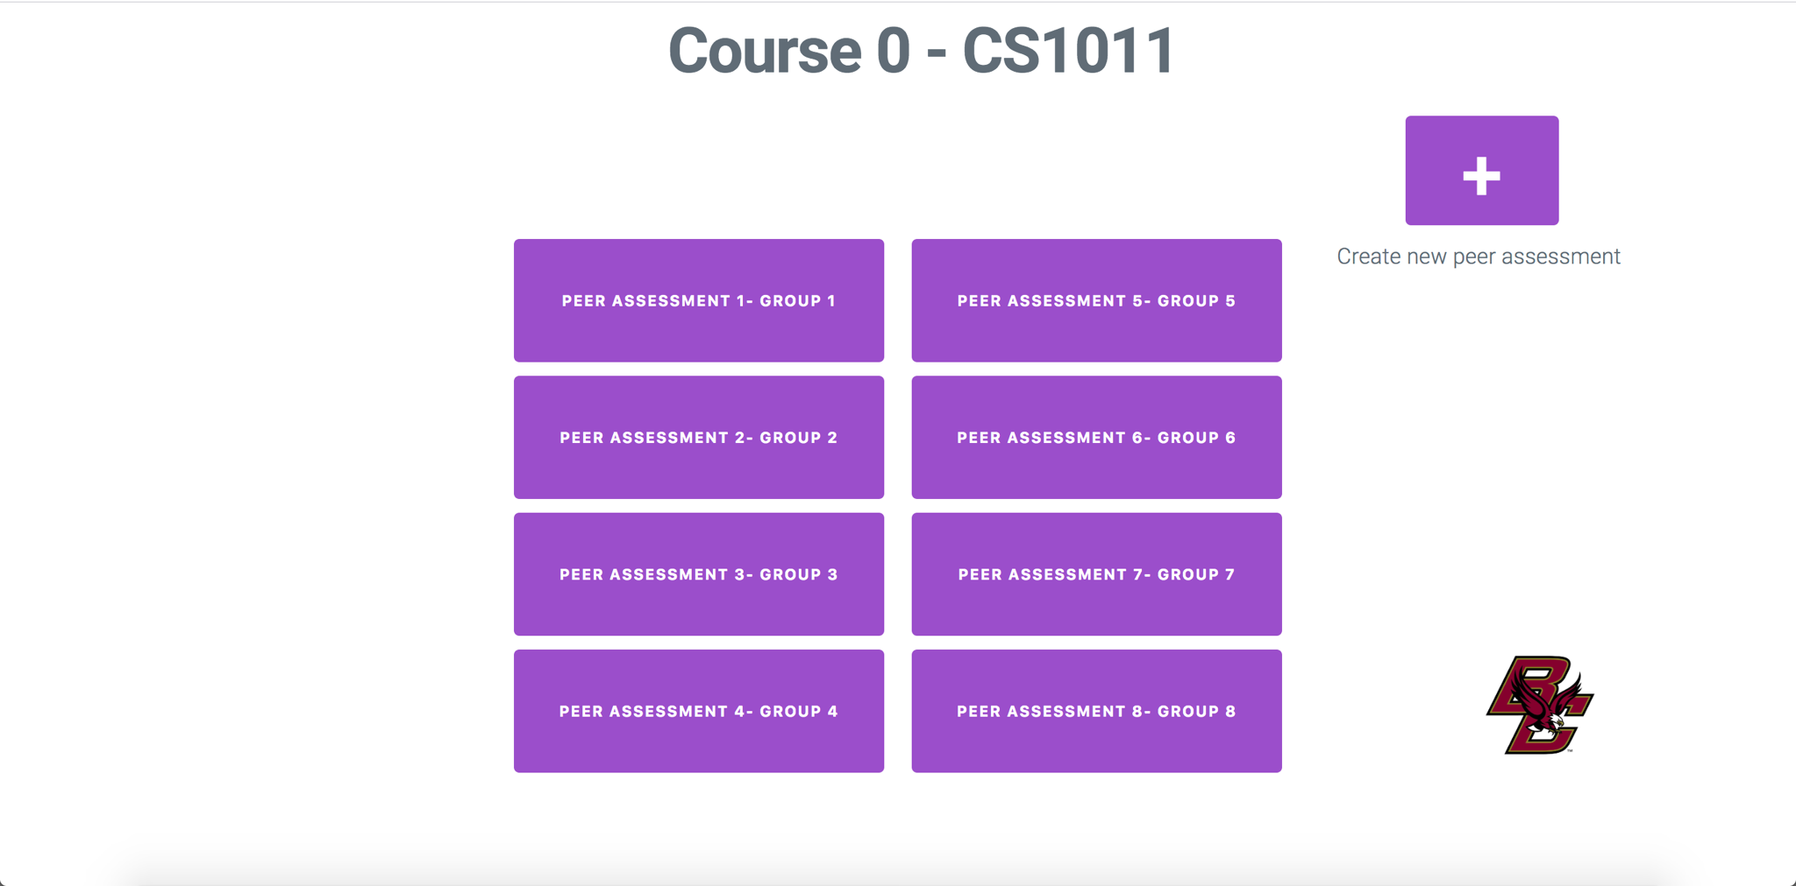
Instructor Landing Page

Slide 6
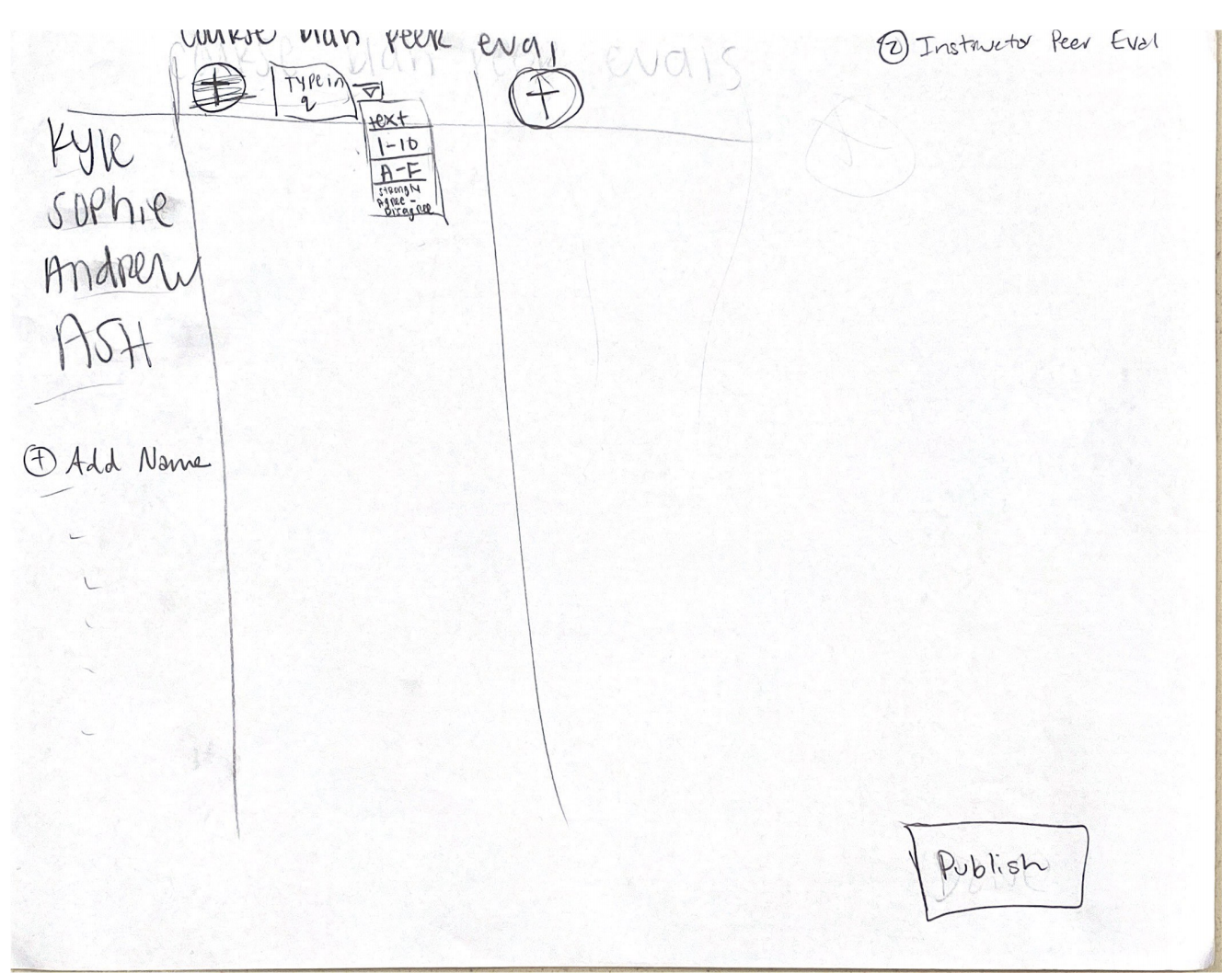
Peer Assessment Creation (Instructor)
Peer assessment creation interface designed to allow for ease of customization via questions, students, etc.
Buttons spaced and positioned in clear and logical locations to improve presentation and reduce chance of accidental publication
Default answer options for each question provided via drop-down menu

Slide 7
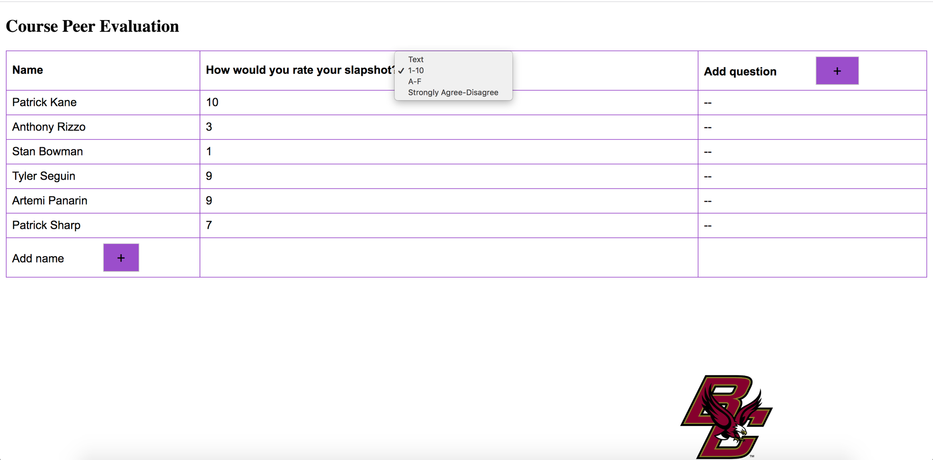
Peer Assessment Creation (Instructor)

Slide 8
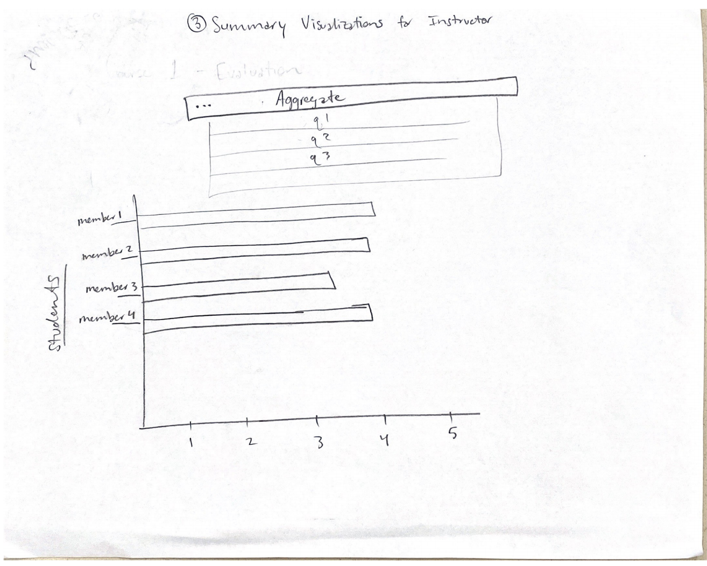
Summary Visualization
Results are displayed for instructor, with page defaulting to aggregate results for each student
The x-axis contains the average answer for each student based on the questionnaire format selected by the instructor
The y-axis contains each student participating in the assessment
Instructors have the option of viewing average results of students for a specific question number

Slide 9
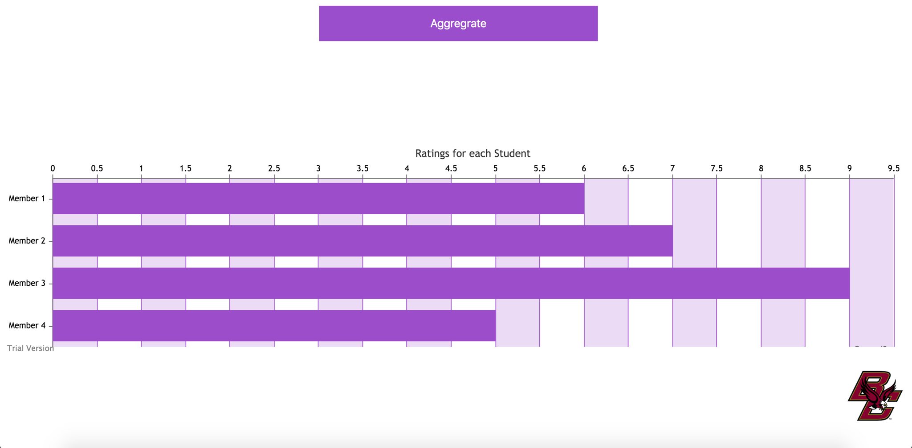
Summary Visualization

Slide 10
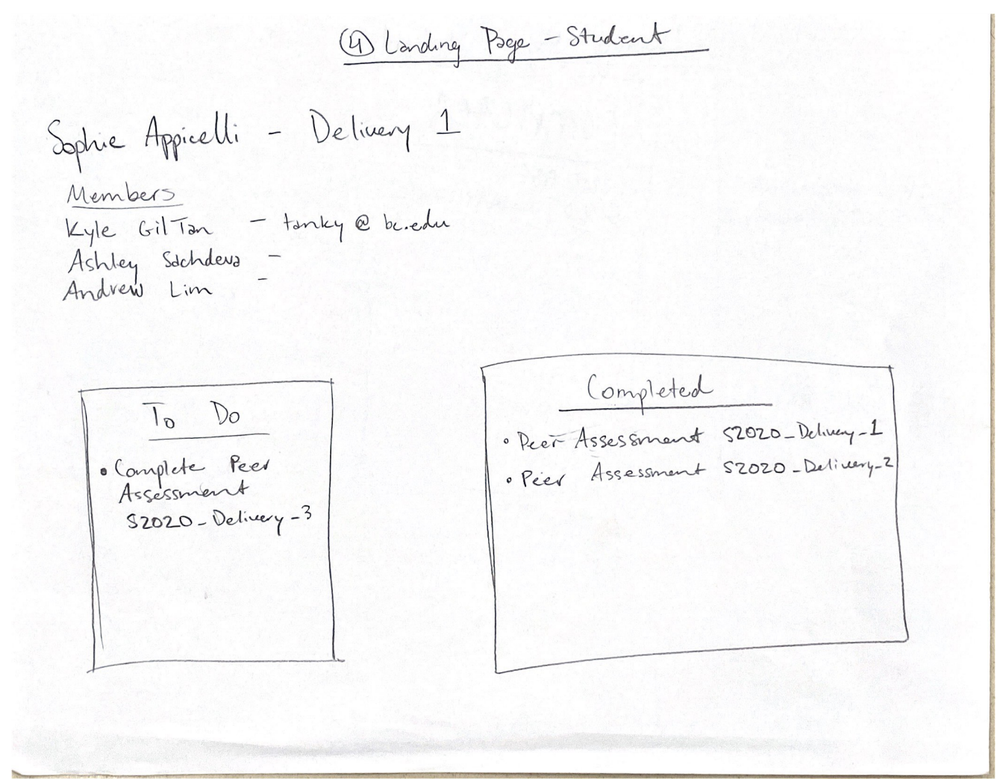
Student Landing Page
Displays general student information as well as relevant team information as per parameters
Keeps lists of available and completed tasks in clearly visible positions without the need for additional menu access
Tasks on To Do List are buttons that redirect student to peer assessment
Tasks on Completed List are buttons that redirected you to your submission

Slide 11
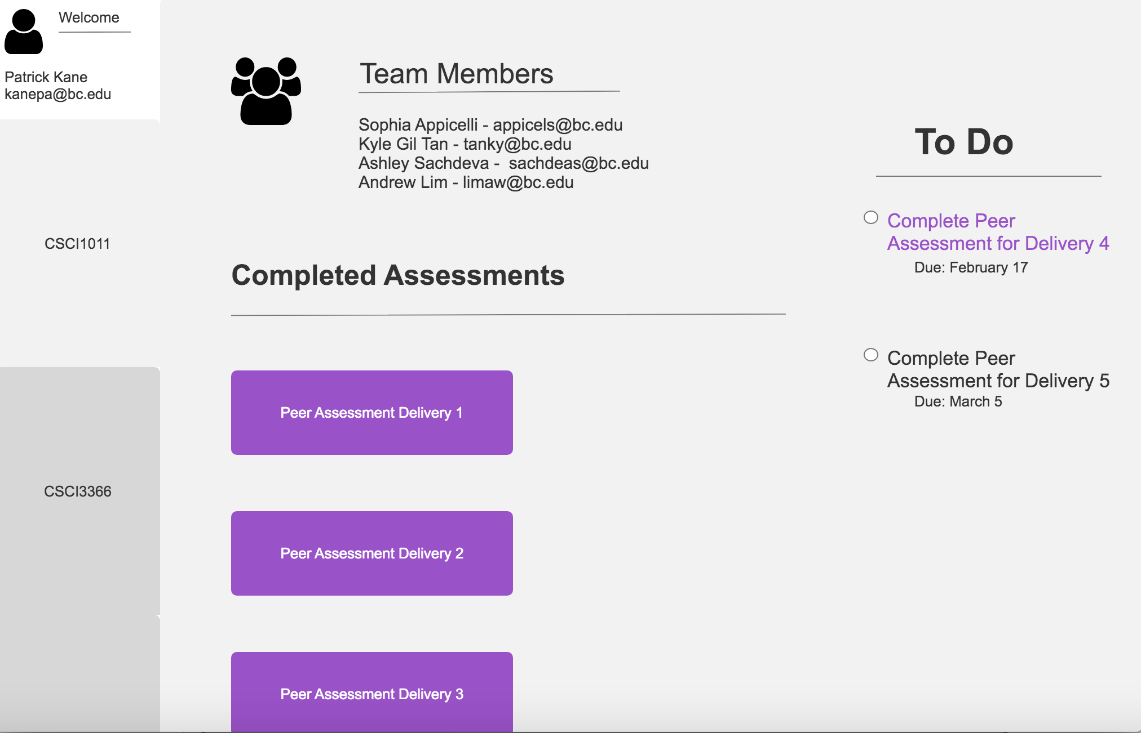
Student Landing Page

Slide 12
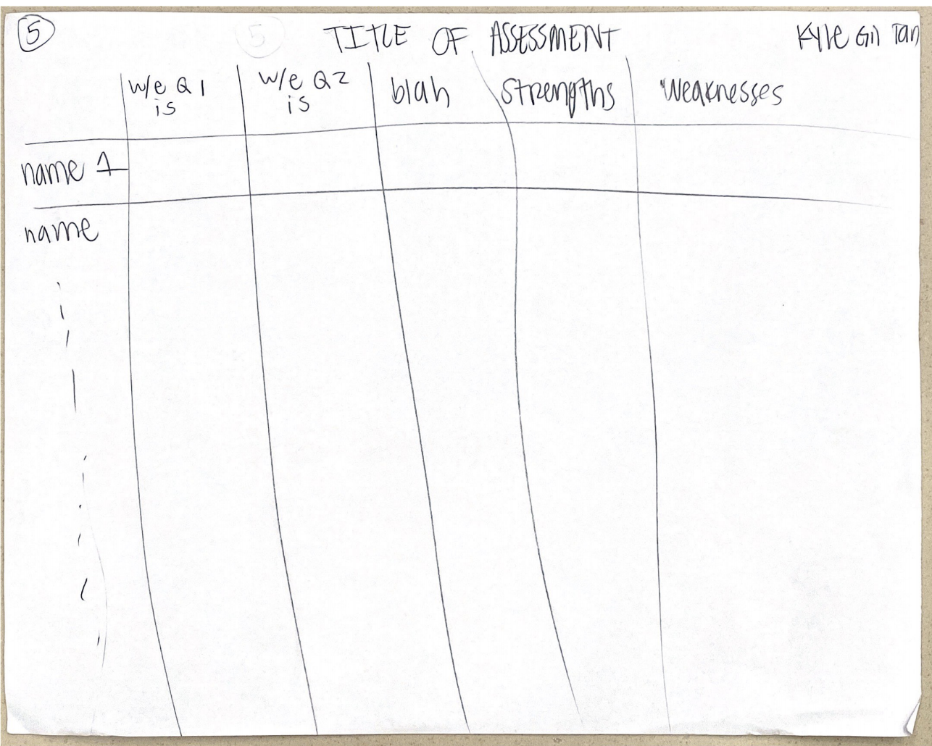
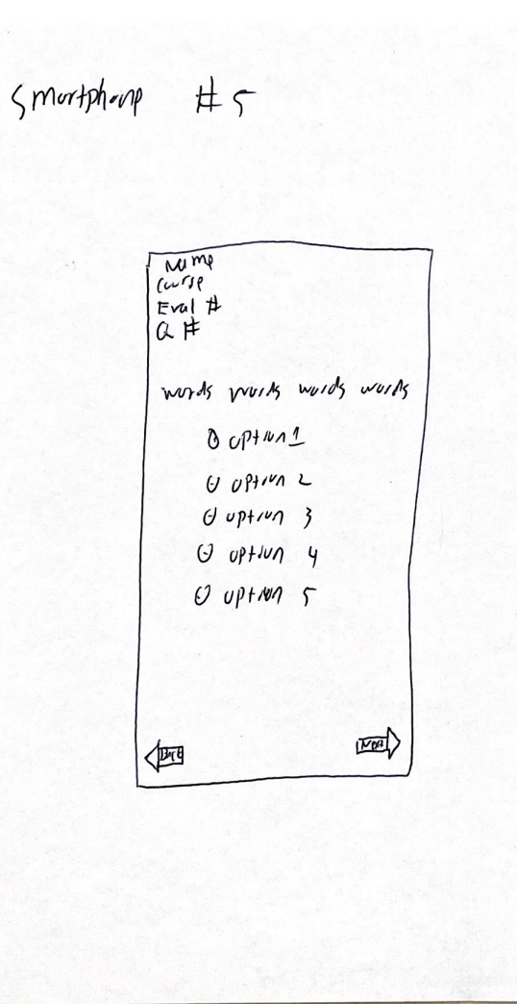
Peer Assessment (Student)
Web interface allows students to see and answer multiple questions at once
Answer choice is limited based on Instructor’s preselected configuration
E.g. 1-10, A-F, Text
Due to resolution restrictions, mobile interface presents peer assessment questions several at a time to make answering easier on smaller screens
Mobile answers are in the form of multiple choice or text box

Slide 13
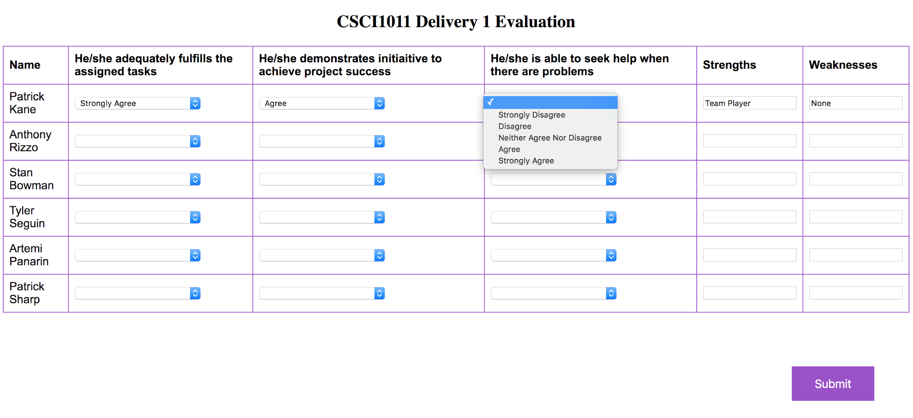
Peer Assessment (Student)

Slide 14

Peer Assessment (Student - Mobile)

Slide 15
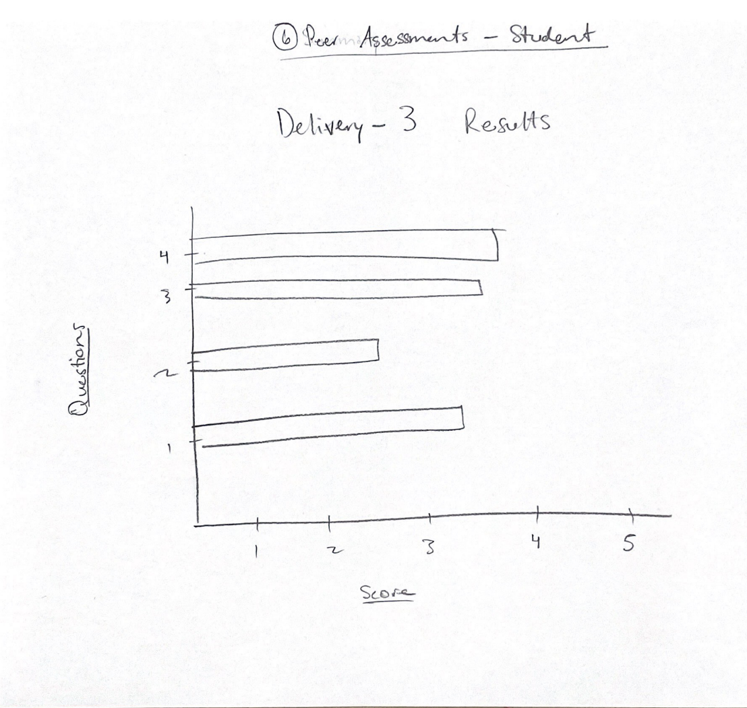
Peer Assessment Results (Student)
Indexes student results for a given peer assessment by question
Current quantify questions on a 1-5 scale to show results for easy comparison
Additional formats to be implemented will allow students to view feedback for short response questions such as strengths/weaknesses

Slide 16
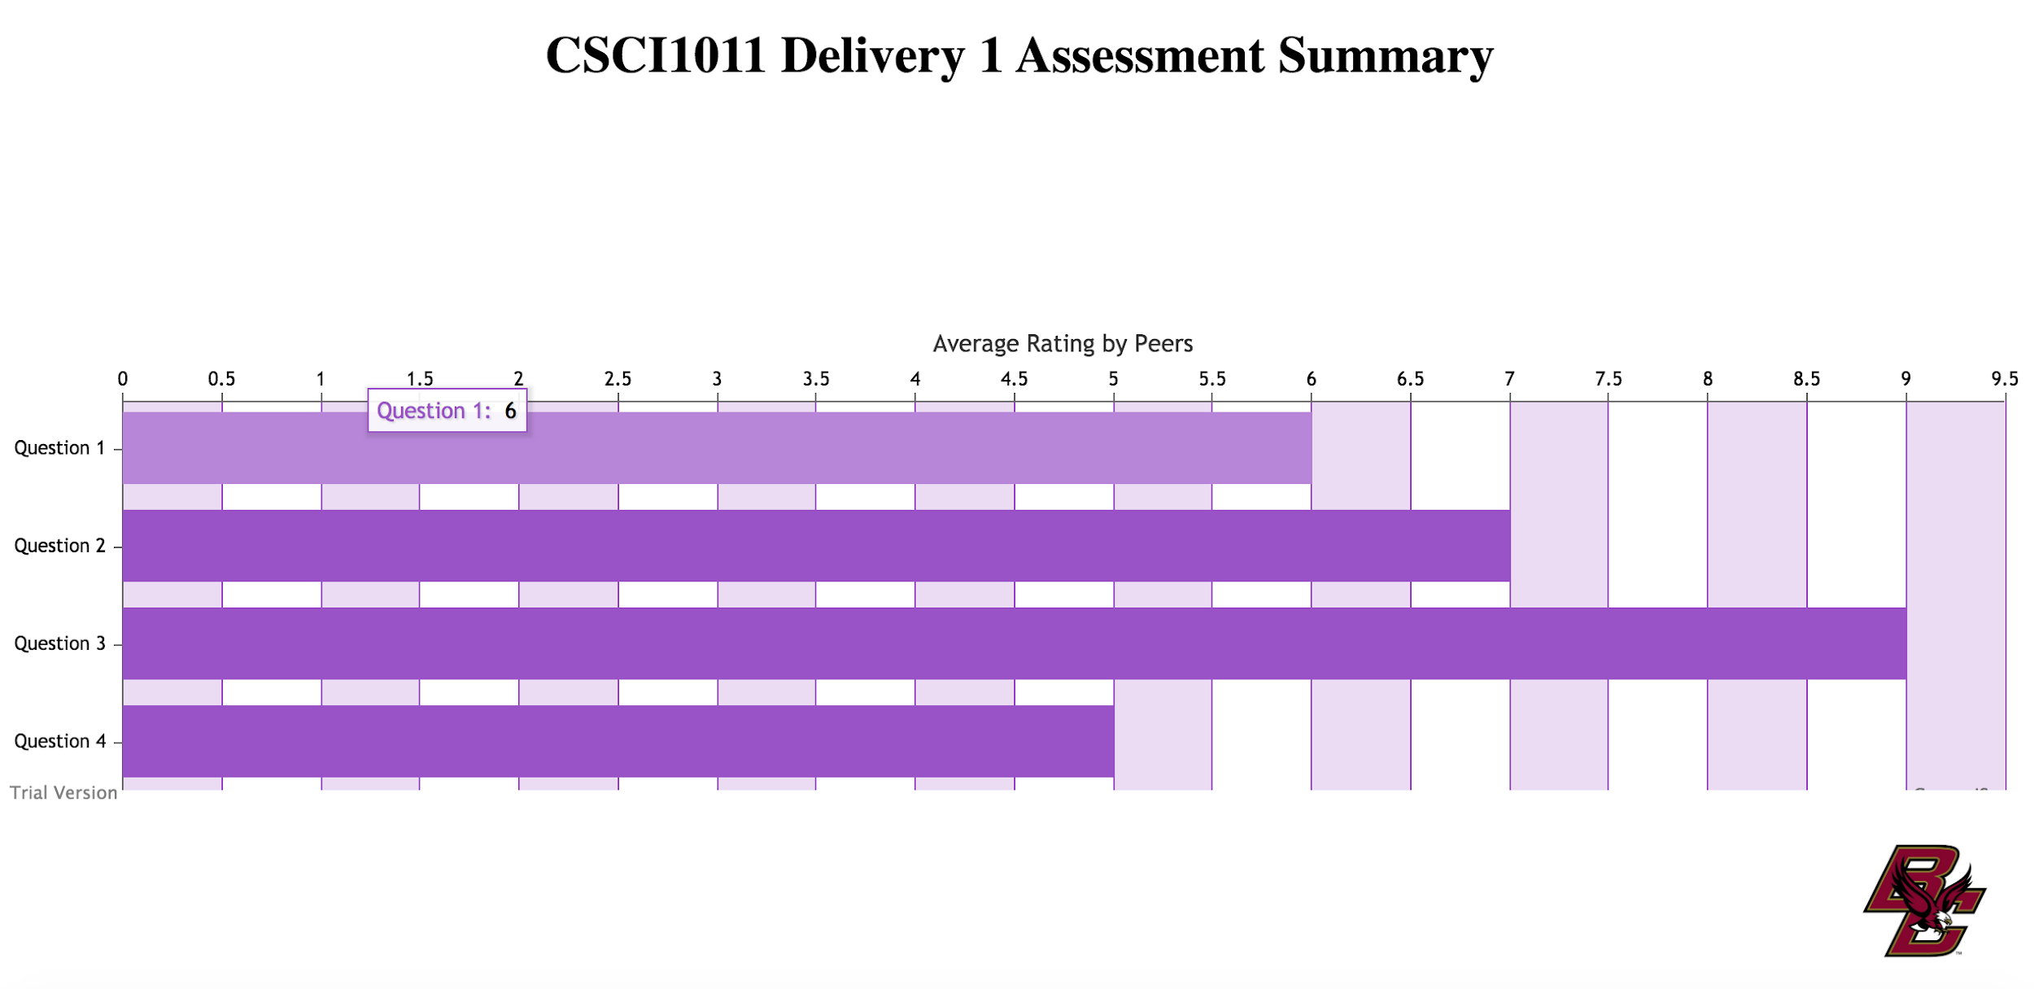
Peer Assessment Results (Student)

